Slide 1


Mass Casualty Management
Learning program
MCM Course Logistics
www.who.int

Slide 2
“Injury-related, mass casualty management, at the level of the Emergency Unit”
“The organization and actions of health staff working in an emergency unit in the first hour after a mass casualty has been declared”

Slide 3
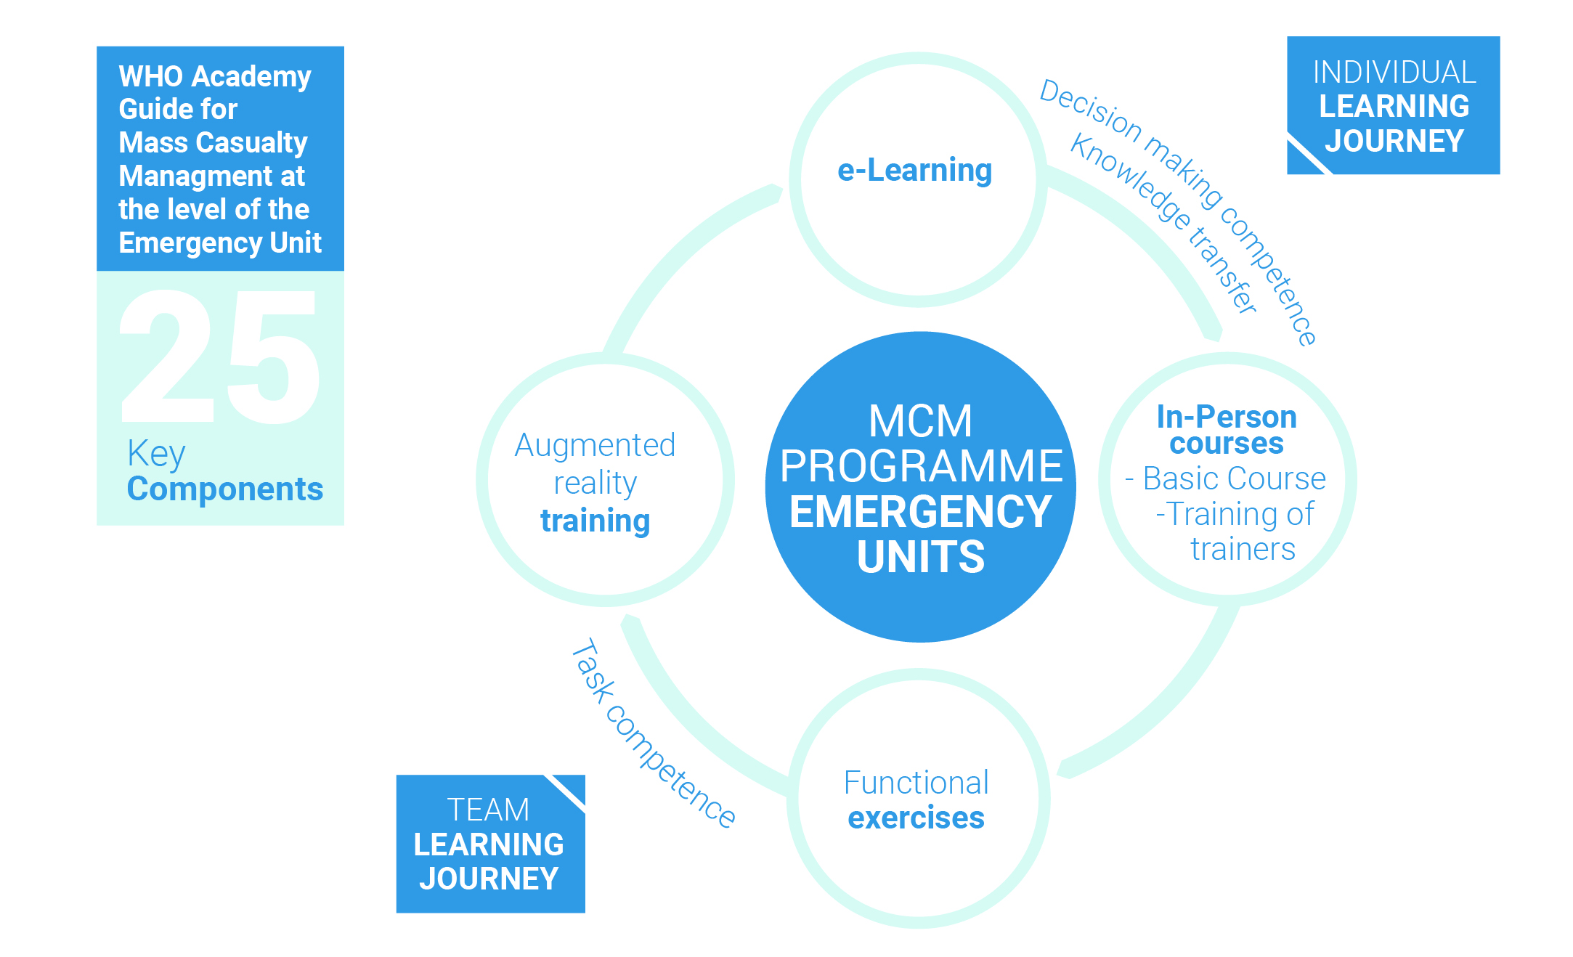

Our Learning Solution for MCM
Usually - 3,5 Days course
In the future - 2 Days course

Slide 4
In Person Learning Experience
3,5
DAYS
 | Morning | Afternoon
DAY 1 | Introduction to MCM and Zone training | Draw your EU and tell us about your MCM practices
DAY 2 | Lecture on triage, green and red zones | TTX 1 - TOPAT Hospital Exercise TTX 2 - Create ZONES + Explain SET ICT ZONES
DAY 3 | Lecture on role training, resource lead, clinical lead and incident commander | TTX 3 - Practice SET ICT ZONES
DAY 4 | Best Practices Developing and executing the MCM plan / Writing exercise MCM Plan Design and Presentation Certification ceremony

Slide 5
Target audience
X 4
Hospitals
Head of the Emergency Unit
Head Nurse of the Emergency Unit
Senior Doctor from the Emergency Unit
Hospital Clinical Director
Hospital Management Representative
ICU & OR Representatives
Head of Security
Emergency Unit Admin person & IT
Hospital Disaster Planning manager

Slide 6
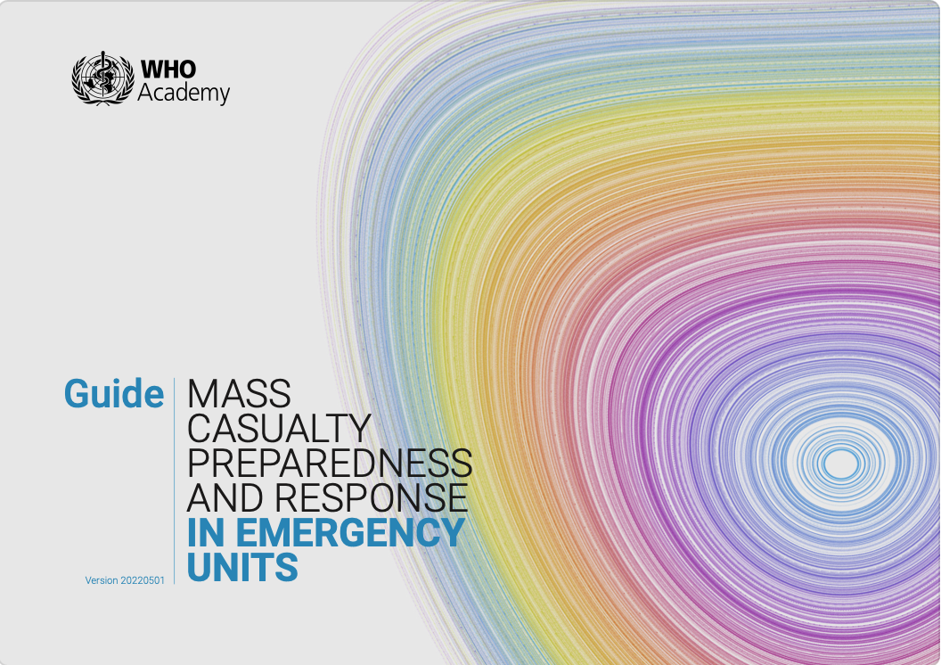
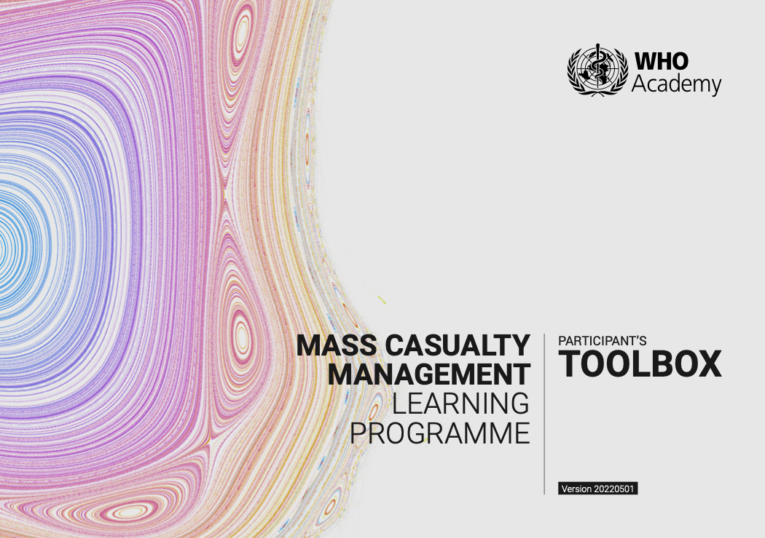
Please refer to these publications

Slide 7
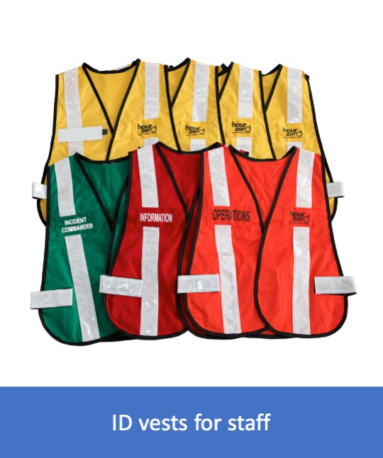




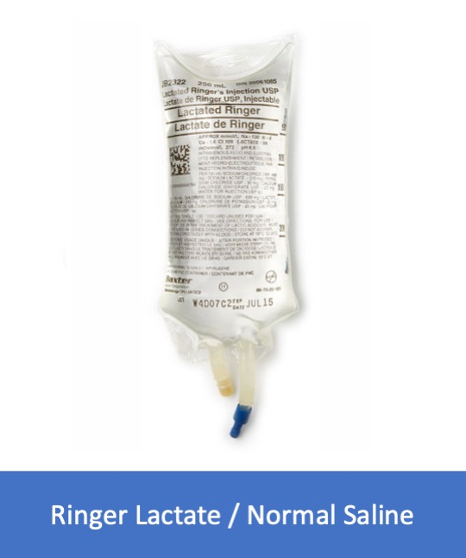
Support materials
KITS’ CARDS
TEMPLATE HOSPITAL - A0 PRINT
MAGNETS

Slide 8
Support materials

Slide 9
Support materials

Slide 10
Support materials

